Slide 1
Validity
Wenchao Ma
University of Minnesota

Slide 2
Validity
Valid research is that which accurately reflects the real world phenomena it is intended to describe (and sometimes, to explain) (deVellis 2011)
Measurement validity: validly measure what we intent to measure
Internal validity refers to researchers’ claims that the data they have measured reveal a causal process at work.
External validity refers to the representativeness, or generalizability of research findings

Slide 3
Definition of measurement validity
1. Validity is about the interpretation and the use of test scores in terms of a specific psychological construct; it is not about the test itself.
2. Validity is a matter of degree; it is not an “all-or-none” issue.
3. Validity is based on solid empirical evidence and theory.
Notes:
Measurement validity refers to the extent that a survey item (or group of items) elicits an accurate description of its target concept (DeVellis 2011). This requires first a clear definition of the target concept, one that suggests some appropriate dimensions that we can measure with our survey questions.
a measure itself is neither valid nor invalid; rather, the issue of validity concerns the interpretations and uses of a measure’s scores.

Slide 4
Contemporary facets of validity
Construct validity
Content evidence
Internal structure evidence
Response process evidence
Relations to other variables evidence
Consequences of testing evidence

Slide 5
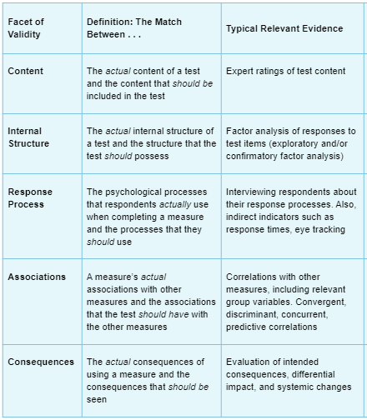
Contemporary facets of validity

Slide 6
Evidence Based on Test Content
The degree to which elements of an assessment instrument are relevant to and representative of the targeted construct for a particular assessment purpose.
Notes:
Evidence based on test content: Previously referred to as content validity, this source of validity evidence involves logically examining and evaluating the content of a test (including the test questions, format, wording, and tasks required of test takers) to determine the extent to which the content is representative of the concepts that the test is designed to measure without either underrepresenting those concepts or including elements that are irrelevant to their measurement.
2. Evidence based on response processes: This source of validity evidence involves observing test takers as they respond to the test and/or interviewing them when they complete the test. We use these observations and interviews to understand the mental processes that test takers use to respond. For instance, if the test was designed to measure logical reasoning, test takers should report mentally processing the test information while they solve the test problems as opposed to relying on memorized answers. If the test is scored by using trained observers or judges, this source of validity evidence also involves exploring whether those observers or judges used the criteria that were defined to document and evaluate test taker behaviors or performances.
3. Evidence based on internal structure: This type of evidence was previously considered part of what was termed construct validity (which we discuss in detail in a later chapter). It focuses on whether the conceptual framework used in test development could be demonstrated using appropriate analytical techniques. For instance, if a test was designed to measure a single concept (such as anxiety), we would analyze the test results to find out how many underlying concepts account for the variations in test taker scores. (One such analysis that we discuss later is factor analysis.) If the test was designed to measure one concept only, the analysis should show that only one concept (presumably anxiety in our example) accounts for a majority of the information the test takers provided. If the analysis suggests that the scores were affected by more than one underlying concept or factor, then we would question whether we had evidence of validity of the test based on its underlying single concept structure.
Studies of the internal structure of the test are also used to determine whether certain items on the test are more difficult for some groups of people than for others, such as would be the case if minority test takers responded to certain items differently than nonminority test takers. This type of analysis may show whether test takers with the same ability, but belonging to different groups, have different probabilities of correctly answering a test question. For example, men and women would probably score quite differently on a test that measures knowledge of childbirth.
4. Evidence based on relations with other variables: Traditionally referred to as criterion-related validity (which we will discuss in the next chapter) and also another part of construct validity, this source of validity evidence typically involves correlating test scores with other measures to determine whether those scores are related to other measures to which we would expect them to relate. Likewise, we would want to know that the test scores are not related to other measures to which we would not expect them to relate. For instance, a test designed to be used in employee selection should correlate with measures of job performance (criterion-related validity). A test of mechanical aptitude should correlate with another test of mechanical aptitude, while not correlating with a vocabulary test (construct validity).
5. Evidence based on the consequences of testing: Any time we make a psychological measurement, both intended and unintended consequences may occur. For example, an intended consequence of a test for personnel selection would be obtaining accurate information for hiring. However, if the test is biased, an unintended consequence might be that test scores appear to favor one group over another. However, it is also important to understand that just because different groups score differently on a test does not automatically mean that the test is biased. If, for instance, the higher scoring group actually possessed more of the skills that the test was designed to measure than the lower scoring group, then the test scores would simply be properly reflecting the differing skill levels between the two groups. (We discuss the issue of test bias in a later chapter, “How Do We Assess the Psychometric Quality of a Test?” which covers the psychometric properties of tests.) Therefore, test users need to be aware that it is important to distinguish between consequences of testing associated with the validity of the test itself (i.e., whether correct inferences are being made from the interpretation of the test scores) versus other outcomes not related to the purpose for which the scores will be used.

Slide 7
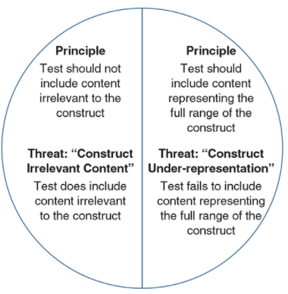
Threats to Content Validity

Slide 8
Threats to Content Validity: Construct underrepresentation
Construct underrepresentation refers to a situation in which test content is defined too narrowly, leaving out important aspects of the construct.
Construct underrepresentation can also occur if a test covers the intended content adequately but does not do so at the intended cognitive level.
Notes:
For example, a licensure test for physicians that requires memorization of facts but has no items requiring application of these facts to diagnose diseases would result in underrepresentation of the appropriate knowledge domain.

Slide 9
Threats to Content Validity: Construct-irrelevant variance
Construct-irrelevant variance occurs when test scores are influenced by factors that are not part of the intended construct.
construct-irrelevant easiness
construct-irrelevant difficulty
Notes:
This is problematic because when irrelevant features of an item affect people’s scores, we cannot be sure of the meaning of these scores. The scores are now influenced by both the construct of interest and the irrelevant source, but we do not know how much influence each has on a given score.
The first occurs when features of the test items that are irrelevant to the construct being measured make them easier for some examinees. For example, the correct answer for a multiple-choice item may contain a clue or be longer than the other options, Students who are test-wise are then likely to choose the correct answer even if they do not have the requisite content knowledge.
Construct-irrelevant difficulty, in contrast, occurs when features of the item that are irrelevant to the construct being measured make the item more difficult for some examinees. A classic example is the inclusion of overly complex language in achievement test items. Some students, notably those whose first language is not English, may fail to answer correctly not because they lack the content knowledge but because they do not understand the question. Unless the purpose of the test is to measure language ability, language complexity should be kept to a minimum to avoid contamination by this source of irrelevancy.
For personality or attitude measures, construct-irrelevant variance is introduced if responses are influenced by social desirability, a tendency to respond in an extreme fashion, or other response styles.

Slide 10
Content validity v.s. Face validity
Face validity answers the question, “Does it appear to the test taker that the questions on the test are related to the purpose for which the test is being given?”
Face validity is never an acceptable means of demonstrating evidence of the validity of a test
Face validity might have important implications for the test’s use

Slide 11
Evidence Based on Internal Structure
Evidence based on internal structure concerns the internal structure or dimensionality of the test
the match between the actual internal structure of a test and the structure that the test should possess
Rosenberg’s (1989) Self-Esteem Inventory was designed to be unidimensional
The Multidimensional Self-Esteem Inventory (MSEI; O’Brien & Epstein, 1988) was designed to measure global self-esteem along with eight components of self-esteem.
Notes:
Some tests are designed to measure a single dimension, or narrow aspect of a test, such as the propensity to buy a particular type of product or ability to add two-digit numbers. Other tests are designed to measure broader, multidimensional constructs such as personality.

Slide 12
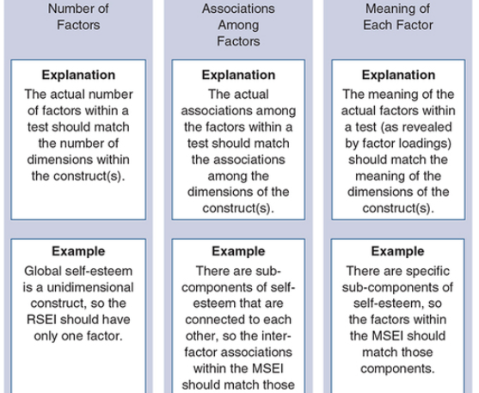
Evidence Based on Internal Structure
Exploratory factor analysis
Confirmatory factor analysis

Slide 13
Evidence Based on Response Processes
Evidence based on response processes concerns the match between the psychological processes that respondents actually use when completing a measure and the processes that they should use.
Score interpretations are based on the assumption that certain cognitive processes have been used
Notes:
Interpretations of item responses typically presuppose that respondents have used certain cognitive processes to produce their answers. For example, cognitive theories of responses to noncognitive items assume that respondents have read and understood the question, searched their memory for relevant information, integrated this information into an answer, and correctly mapped this answer onto the response options provided. However, what if the respondent has simply chosen the middle response option without even reading the item
In the context of achievement testing in mathematics, it is common to use word problems that require a student to determine which type of solution is required. But what if a student has memorized key features of such problems that allow for determining the appropriate solution strategy without using the intended reasoning processes?
In either case, the validity of the test could be problematic.

Slide 14
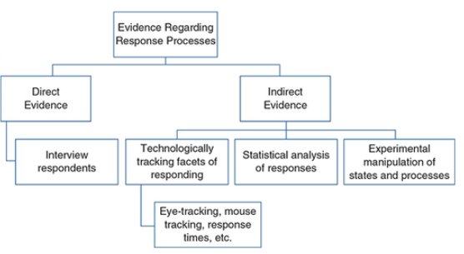
Evidence Based on Response Processes

Slide 15
Evidence Based on Association with Other Variables
Evidence based on association with other variables involves the match between a measure’s actual associations with other measures and the associations that the test should have with those other measures.
If a test’s actual correlations with the other measures do indeed match the correlations suggested by the nature of a particular construct, then we gain support for the interpretation of the test as a measure of that construct.

Slide 16
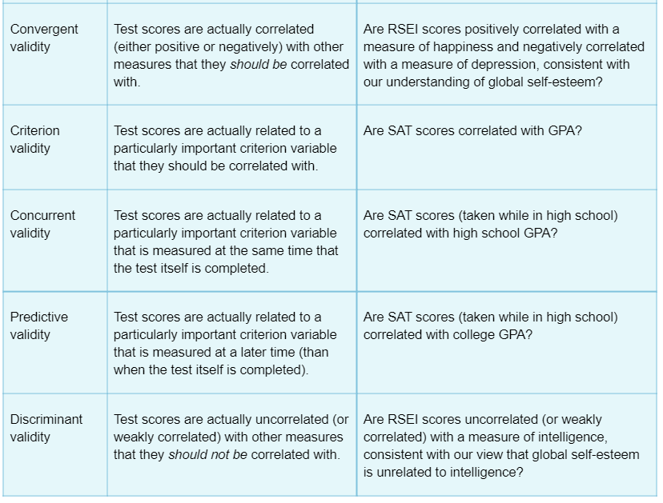
Different types of validity evidence based on association with other variables

Slide 17
Evidence based on relations to other variables
Test–criterion relationships
Convergent evidence
Discriminant evidence
Notes:
In many cases, interpretations and uses of test scores rely on their relation with other variables. For example, a test may be used to predict which job applicants will make the best employees. Or the theory underlying a test might suggest that those with a specific psychological diagnosis, such as depression, should obtain higher scores than those without such a diagnosis. Such relations are measured by correlation coefficients or regression coefficients from either linear or logistic regression, or by tests of mean differences in test scores across groups, with the choice among the methods depending on the types of variables involved.

Slide 18
Evidence based on relations to other variables
Test–criterion relationships refer to situations in which test scores are used to predict future performance or current status on some criterion:
Predictive validity
the extent to which a score on a scale or test predicts scores on some criterion measure
Example: GRE
Concurrent validity
The extent to which one test can be used as an alternative to another
Example: shorter form of a longer test; computerized version vs paper-and-pencil test

Slide 19
Evidence based on relations to other variables
Convergent evidence
test scores should be related to scores from other tests of the same or similar constructs
Discriminant evidence
test scores should be less strongly related to scores from tests measuring dissimilar constructs
Notes:
Convergent validity is the degree to which concepts that should be related theoretically are interrelated in reality. Discriminant validity is the degree to which concepts that should not be related theoretically are, in fact, not interrelated in reality. You can assess both convergent and discriminant validity using the Multitrait–multimethod .

Slide 20
Internal Validity
Internal validity refers to how well a researcher’s survey design is testing the true relationship between the independent variable and dependent variable (Chambliss and Schutt 2013).
Internal validity is established when a researcher has provided sound arguments, adequate statistical controls, and rigorous research design to establish a causal relationship between two correlated variables.

Slide 21
External Validity
External validity is the extent to which research findings can be generalized to other populations, environments, times, and settings (Flick 2011).
Notes:
In practical terms, external validity is associated with where else the results of a study can be applied. Do the findings of the research also hold outside the study (i.e., external to it)?
There are three potential threats to a survey’s external validity; these are based on the nongeneralizability of the population, the situation, or the time frame under study.
Research on close adult friendships conducted among college students may not necessarily be generalizable to a more general population of adults. When asking college students about their close friendships, a researcher must note that they are mostly a given age, are mostly unmarried, and may have more liberal ideas about cross-gender friendships than members of a wider population.

Slide 22
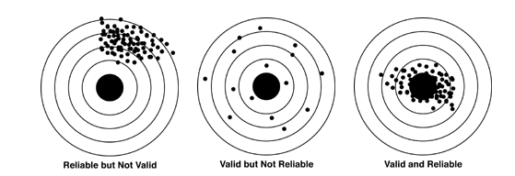
Reliability and measurement validity

